Slide 1

Sprint 1 - Review
Grading Areas | Grade
Clarity – flow / structure, organization, logic, rationale, articulation including messaging & scrum “sprint shippable product” | A-/B+
Contents – completeness, breadth and depth of coverage, research quality | B+
General – innovation, good “adds”, overall style | B+
References, checklist items: English/spelling ‘ scrum artifacts / KPIs adherence (including and not limited to planning, daily scrum, retrospective) | A
Total points | A- (91) with grace point
[1]
Team 1
Moushumi Bhattacharya | Samreen Kazimi | Mukesh Ganesh | Yash Kamdar
Simran Joneja | Monica Ashok Kumar Jain | Keanu Izadian | Niyati Khamar
Ref: [1] https://editor.freelogodesign.org/?lang=en&logo=095b1a07-720b-4f76-8b8d-9fc4bf701c23&companyname=&category=0
Notes:
GRADE = 90 (clarity) + 88 (contents) + 88 (General) + 96 (checklist) = 90.5 (A-)

Slide 2
Contents
1. | Company Profile
2. | Project Scope
3. | Objectives
4. | Key Initiatives
5. | KPIs for Recruitment
6. | Scrum Personas
7. | Product Roadmap
8. | Daily Scrum - Agenda
9. | Daily Scrum Logs
10. | End User Stories
11. | Sprint 1 - Demo
12. | Burndown Chart

Slide 3
Company Domain - Business Intelligence
Company Overview - At Winformatica Inc., we drive digital transformation so that you can better predict costs and manage risks at your company with the help of our Analytics and Visualization tool. Whether you are a small or a large company, Winformatica Inc. meets you where you are and our product fits seamlessly into your workflows. We are working on company expansion and thereby need a good recruitment strategy. We plan to use our internal analytics knowledge and inhouse HR team to implement an effective blind recruitment process for our company with the help of AI recruiting tools.
Company Profile

Slide 4

Benchmark and incorporate AI-powered recruiting tools to support sourcing, screening and interviewing candidates to adhere to D&I guidelines of recruitment and retention
Project Scope
[1]
[1] https://www.clipartkey.com/view/TbbbJw_diversity-and-inclusion-icon/

Slide 5
Objectives
Gain insights on the existing recruitment process of traditional screening and shortlisting candidates by holding knowledge transfer sessions with the subject matter experts (HR Specialists, Recruiters, etc)
Determine the most promising methods for recruiting diverse candidates and remove existing unconscious bias. Automate the on going rote functionality of recruiting by integrating artificial intelligence such as machine learning or predictive algorithms.
Perform market research on different recruitment tools currently available and propose best fit.
Design a better candidate experience

Slide 6
Key Initiatives
[2]
[1]
Candidate Interviews
Interviews with candidates
Understand facial expressions
Infer Personality Traits
Analyze interview transcripts
03
Candidate Sourcing
Multi Channel sourcing
Specify keywords/criteria
Real-time messages/updates
[2]
01
02
Candidate Screening
Key analysis to screen resumes
Conduct tests and quizzes
Skill based screening
[2]
[1] PowerPoint SmartArt
[2] https://www.hrtechnologist.com/articles/digital-transformation/3-usecases-of-ai-in-recruitment/

Slide 7
KPIs for Recruitment
Adverse Impact
AA
Adverse Impact Determination = (Applicant success rate of group A / Applicant success rate of group B)
[1]
[1]
Time to Hire
Date of Hire - Candidate enters ATS
Time to Hire
Time to Hire = Date of hire + Date candidate enters ATS
[1]
Quality of Hire
(Performance + Productivity + Retention)/N
[1]
Offer acceptance rates
No. Of accepted Offers / Total no. of Offers
[1]
Candidate Experience
Net Promoter Score = (% of candidates who rate the experience 9 or 10) - (% of candidates who rate the experience 6 and below)
[1]
[1] www.hirevue.com/blog/recruiting-kpis-5-types-of-metrics

Slide 8
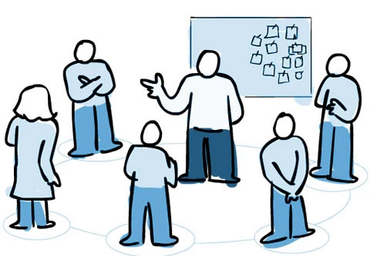
Scrum Personas
[1]
[1] https://agilefellow.com/2016/06/30/daily-scrum-personas/

Slide 9

[1]
Product Owner - Joanna
Bio:
Joanna has been a part of Winformatica since the beginning. Her visionary perspectives have earned her opportunities to work globally across Fortune 500 companies before Winformatica.
She uses social media to share her vision and inspire other people.
Responsibilities:
Owns the shippable product
Creates user stories and tracks the work done
Responsible for the burn up chart
[1] https://www.kindpng.com/imgv/bmbihx_-certified-scrum-product-owner-by-stacia-viscardi/

Slide 10
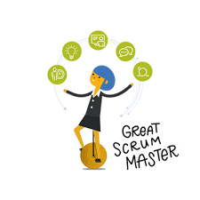
[1]
Scrum Master - Wendy
Bio:
Wendy is a certified Scrum Master (CSM) with 5+ years of experience. She has a proven track record of raising revenue and cutting costs.
She enjoys blogging about her weekend road trips.
Responsibilities:
Pulls EPIC stories from the backlog
Conducts the Sprint Planning, Retrospective and daily stand up meetings
Responsible for burndown chart
[1] https://images.app.goo.gl/TNPnapt8SWj47h1y9

Slide 11

[1]
HR Specialist - Amanda
Bio:
Amanda has extensive experience across a variety of people functions including talent management, employee relations and data management.
She has commendable oratory skills.
Responsibilities:
Subject matter expert (functional)
Explains the as-is process
Identifies appropriate KPIs and analyzes the product fit
[1] https://depositphotos.com/224514076/stock-illustration-specialist-icon-specialist-symbol-design.html

Slide 12

Research Analyst - Mike
[1]
Bio:
Mike has been a part of Winformatica Inc since 2017. He joined as a Research Analyst after his graduation and is determined to achieve goals that contribute to the growth of the organization.
When not at work, he loves traveling and hiking!
Responsibilities:
Research for AI Tools (tech & implementation)
Benchmarking, SWOT Analysis and analyze the product fit
[1] https://images.app.goo.gl/AAvvZJtH2Bf63U1E9

Slide 13

[1]
Technical Analyst - David
Bio:
David is a strategic technical analyst and subject matter SME in the business intelligence domain. He has excellent visual awareness and a great aesthetic eye which have made him well known for many of his contributions.
He loves spending time with his kids and cooking dinners.
Responsibilities:
Resolve issues while integrating with the existing system
Support research analysts in technical challenges
Implementation and enforcement of tool usage
[1] https://images.app.goo.gl/MJJXcQNVKAaLLvoK8

Slide 14

[1]
Sprint Consolidator - Susan
Bio:
Susan has been with the firm since the last 3 years. She is an avid contributor of Sprints and her day involves documenting Sprint activities, daily scrum logs on Confluence.
In her free time, she enjoys freelance writing and fictional writing.
Responsibilities:
Collect Sprint content from scrum team members
Consolidate the final deck for Sprint Review and Retrospective
[1] https://images.app.goo.gl/4zKajKVbXjBCfbVS8

Slide 15



PRODUCT ROADMAP
[1]
Requirement Analysis
Customization Needs
Sprint Consolidation
Sprint Planning
Understanding HR Practices
Employee Survey
Need for Customization
User Testing
Final Tool Recommendation
Proposal Documentation
Highlight Change
Management Needs
M2
List of Tools Finalised
M1
M3
M4
Tools Selection Complete
Tool Incorporated
1 week
Problem Defined
2 Weeks
1 Weeks
02
S1 Start
20th April
S1
01
03
2 Weeks
S2 Start
11th May
S2
1 Week
S0
Market Research
Integration Testing
Sprint 2 Review
AI Tool Research
Benchmarking
Categorize Tools
HR & TA Buy-In
Iteration 1, 2,3
Sprint 2 Retrospective
Analyse the Product fit
Consensus Meeting
Technical Analysis
29th May
Backlog Grooming
Sprint 2 Demo
1st June
Review of backlog items
S1
End of Sprint 1
Sprint 1 Retrospective & Demo
Sprint 2 Planning
[1] Powerpoint Smart Art

Slide 16
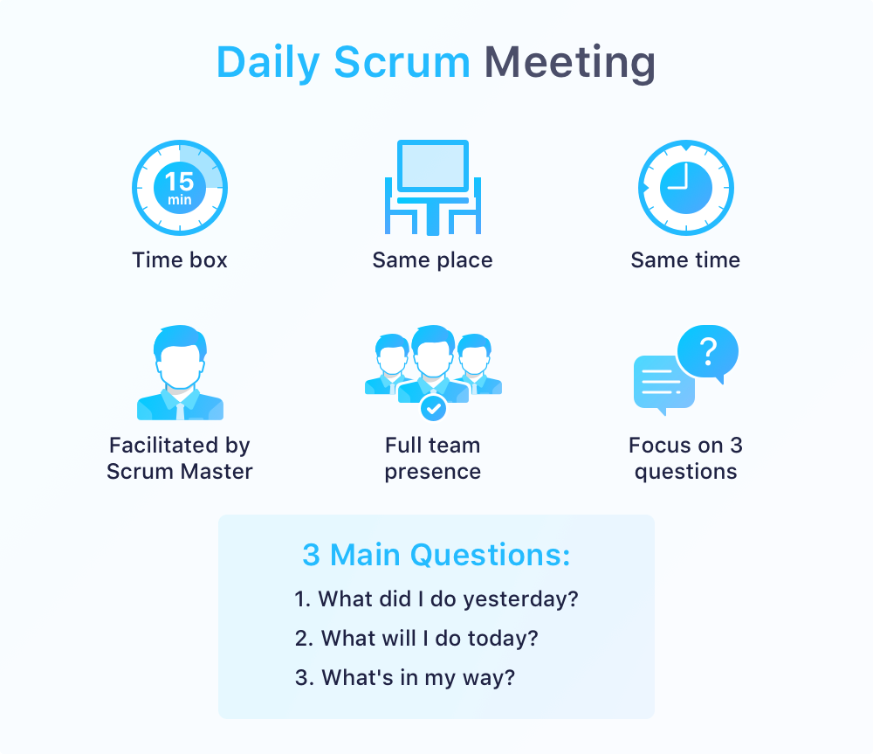
Daily Scrum - Agenda
[1]
Daily stand up meetings were held for from 11 am - 11 : 15 am
Stand up meetings conducted over Zoom call
Duration of the stand up meeting was limited to 15 minutes
Stand up meetings were run by the Scrum Master
Each member responsibly answered 3 key questions - previous day achievement, plan for the day and blockers (if any)
Product Owner was a part of the stand up meetings as well - to resolve issues that the team had.
[1] https://startinfinity.com/product-management-framework/scrum-sprint/scrum-meeting-daily-standup

Slide 17
Daily Scrum - Logs: Week 1
Team Member | Monday | Tuesday | Wednesday | Thursday | Friday
 | Daily Standup | Daily Standup | Daily Standup | Daily Standup | Daily Standup
Amanda | Understanding user story requirements | Call for a discussion with HR Team | Study steps in the current process | Study steps in the current recruitment | Understand current recruitment status
Mike | Understanding user story requirements | Call for a discussion with the HR Team. Meet with Joanna | Discuss points for candidate survey | Formulate points for the candidate survey | Enlist candidates to be part of the survey
Susan | Understanding user story requirements | Discuss about template for documentation | Outline the best practices with Wendy | Share the in progress template for sanity check,review points | Finalise on the format and the contents
David | Understanding user story requirements | Initiate discussion with Mike related to system architecture | Share important follow-up documents with RA team | Discussion with Amanda about key do’s and don'ts | Clarify needs and requirements based on D&I with Joanna

Slide 18
Daily Scrum - Logs: Week 2
Team Member | Monday | Tuesday | Wednesday | Thursday | Friday
 | Daily Standup | Daily Standup | Daily Standup | Daily Standup | Daily Standup
Amanda | Make a report of the studied steps | Discuss report with HR Team | Analyze the report and study statistics | Figure out most time consuming process | List the most time consuming process
Mike | Design questions to be included in the survey | Formulate employee sentiments, recruitment, boarding experience related questions | Analyze survey responses | Perform SWOT analysis of D&I | Analyse and discuss about the resume sourcing channels
Susan | Discuss about the flow of the proposal deck | Nothing to discuss | Nothing to discuss | Share the incomplete proposal deck for Wendy’s buy-in | Review points from Wendy and Joanna
David | Discussion with Mike about skill based survey questions | Discussion with Amanda & Mike about survey rollout | Nothing to discuss | Chalk out a rough employee group structure with Mike | Nothing to discuss

Slide 19
Daily Scrum - Logs: Week 3
Team Member | Monday | Tuesday | Wednesday | Thursday | Friday
 | Daily Standup | Daily Standup | Daily Standup | Daily Standup | Daily Standup
Amanda | Identify bottlenecks in recruiting strategy | Identify gaps to be bridged | Meet with Sprint Consolidator | Work with Sprint Consolidator on the deck | Final changes and review of the deck
Mike | Research about the existing AI tools | Research about the existing AI tools | Categorize tools that help meet challenges | Benchmark shortlisted tools | Final changes and review of the deck
Susan | Integrate all the questions | Nothing to discuss | Nothing to discuss | Discuss proposal changes with Amanda and Wendy | Final changes and review of the deck
David | Nothing to discuss | Walkthrough with Mike to categorize AI tools | Review categorization with Wendy | Nothing to discuss | Final changes and review of the deck

Slide 20
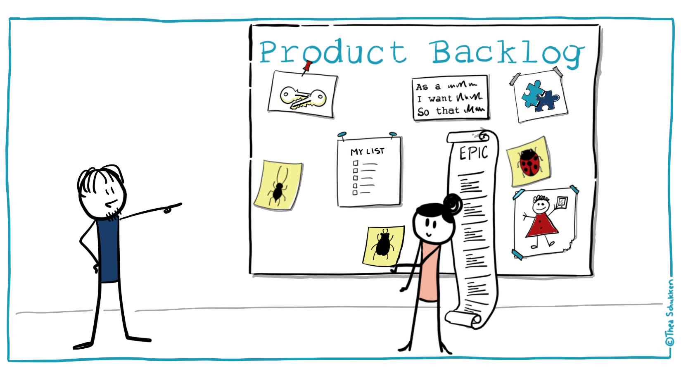
End User Stories
[1]
[1] https://images.app.goo.gl/ih3v2MXCqkW6Csic9

Slide 21
Technical Recruiter
User Stories | Acceptance Criteria
As a Technical Recruiter I want to narrow down the keywords and technical skills required for a specific job role so that the right kind of candidates, with a matching skill set can be sourced. (Priority: Low) | Itemize keywords Enumerate technical skills needed for a job
As a Technical Recruiter I want to be able to check whether the candidate plagiarized code during the coding round of screening so that we do not give the candidate merit for said code. (Priority: Medium) | Perform plagiarism checks on code
As a Technical Recruiter, I want to categorise and screen the resumes using the tool so that I can screen selective resumes that help meet challenges of existing recruitment process. (Priority: Medium) | Categorise the resumes Use a tool to screen the resumes

Slide 22
HR Professional
User Stories | Acceptance Criteria
As a HR Professional, I want to leverage AI to evaluate candidates based on their key personality traits thereby reducing human bias and encouraging inclusiveness. (Priority: Low) | Evaluate candidates using Artificial Intelligence Use AI to assess candidate personality traits Tool to scientifically screen candidates to measure facial expressions and identify their mood
As a HR Professional, I want to reduce the time of a candidate’s journey to candidate interview so that the time and cost can be reduced for recruitment process. (Priority: Medium) | Making use of video interview platforms
As a HR Professional, I want to uncover identifiable patterns of at-risk employees planning to leave for D&I issues so that attrition can be curbed. (Priority: Medium) | Monitor employee behaviour Ensure D&I is in check

Slide 23
HR Analyst
User Stories | Acceptance Criteria
As a HR Analyst I want to identify any underlying issues with HR practices so that I can assist in ensuring that they adhere to the organisations policies and objectives. (Priority: Medium) | Study current HR practices in the company Validate if practices adhere to company standards
As a HR Analyst I want to conduct in-depth research about occupations and job descriptions so that I can focus on worker classification and studying the effects of industry and occupational trends upon worker relationships. (Priority: Medium) | Researched data about occupations Researched data of job descriptions Analyze trends on worker relationships
As a HR Analyst I want to be able to keep track of key candidate and hiring metrics so that I can analyze and visualize the data for pinpointing underlying issues and insights that executives can utilize to make decisions. (Priority: High) | Key candidate list Metrics for hiring

Slide 24
Diversity & Inclusion Specialist
User Stories | Acceptance Criteria
As a Diversity & Inclusion Specialist I want to support and guide the recruitment team so that we can help create a brand that appeals to diverse applicants and removes bias. (Priority: Medium) | Trainings and courses pertaining to diversity and inclusion
As a Diversity & Inclusion Specialist, I want to implement policies and initiatives so that I can drive cultural change across the organisation. (Priority: High) | Study current policies Initiate new policies that support D&I
As a Diversity & Inclusion Specialist, I want to highlight some key personal traits like empathy and resilience so that the organisation can hire candidates who align well with the organisation’s diversity initiatives. (Priority: High) | Narrow down salient personal traits that align with the company’s diversity policy

Slide 25
Applicant
User Stories | Acceptance Criteria
As an applicant, I want to be better informed about the job description so that I can identify whether a job listing suits my profile (Priority: Medium) | Detailed job description with skills and responsibilities tailored for a specific role
As an applicant, I want a quicker hiring decision so that I’m aware of my candidacy with respect to a particular company (Priority: High) | Time bound hiring decision Scheduled responses
As an applicant, I want interviews to take place at a scheduled time so that I’m better prepared. (Priority: High) | There should be no communication gaps Rescheduling to be avoided as it puts the candidates under tremendous pressure

Slide 26
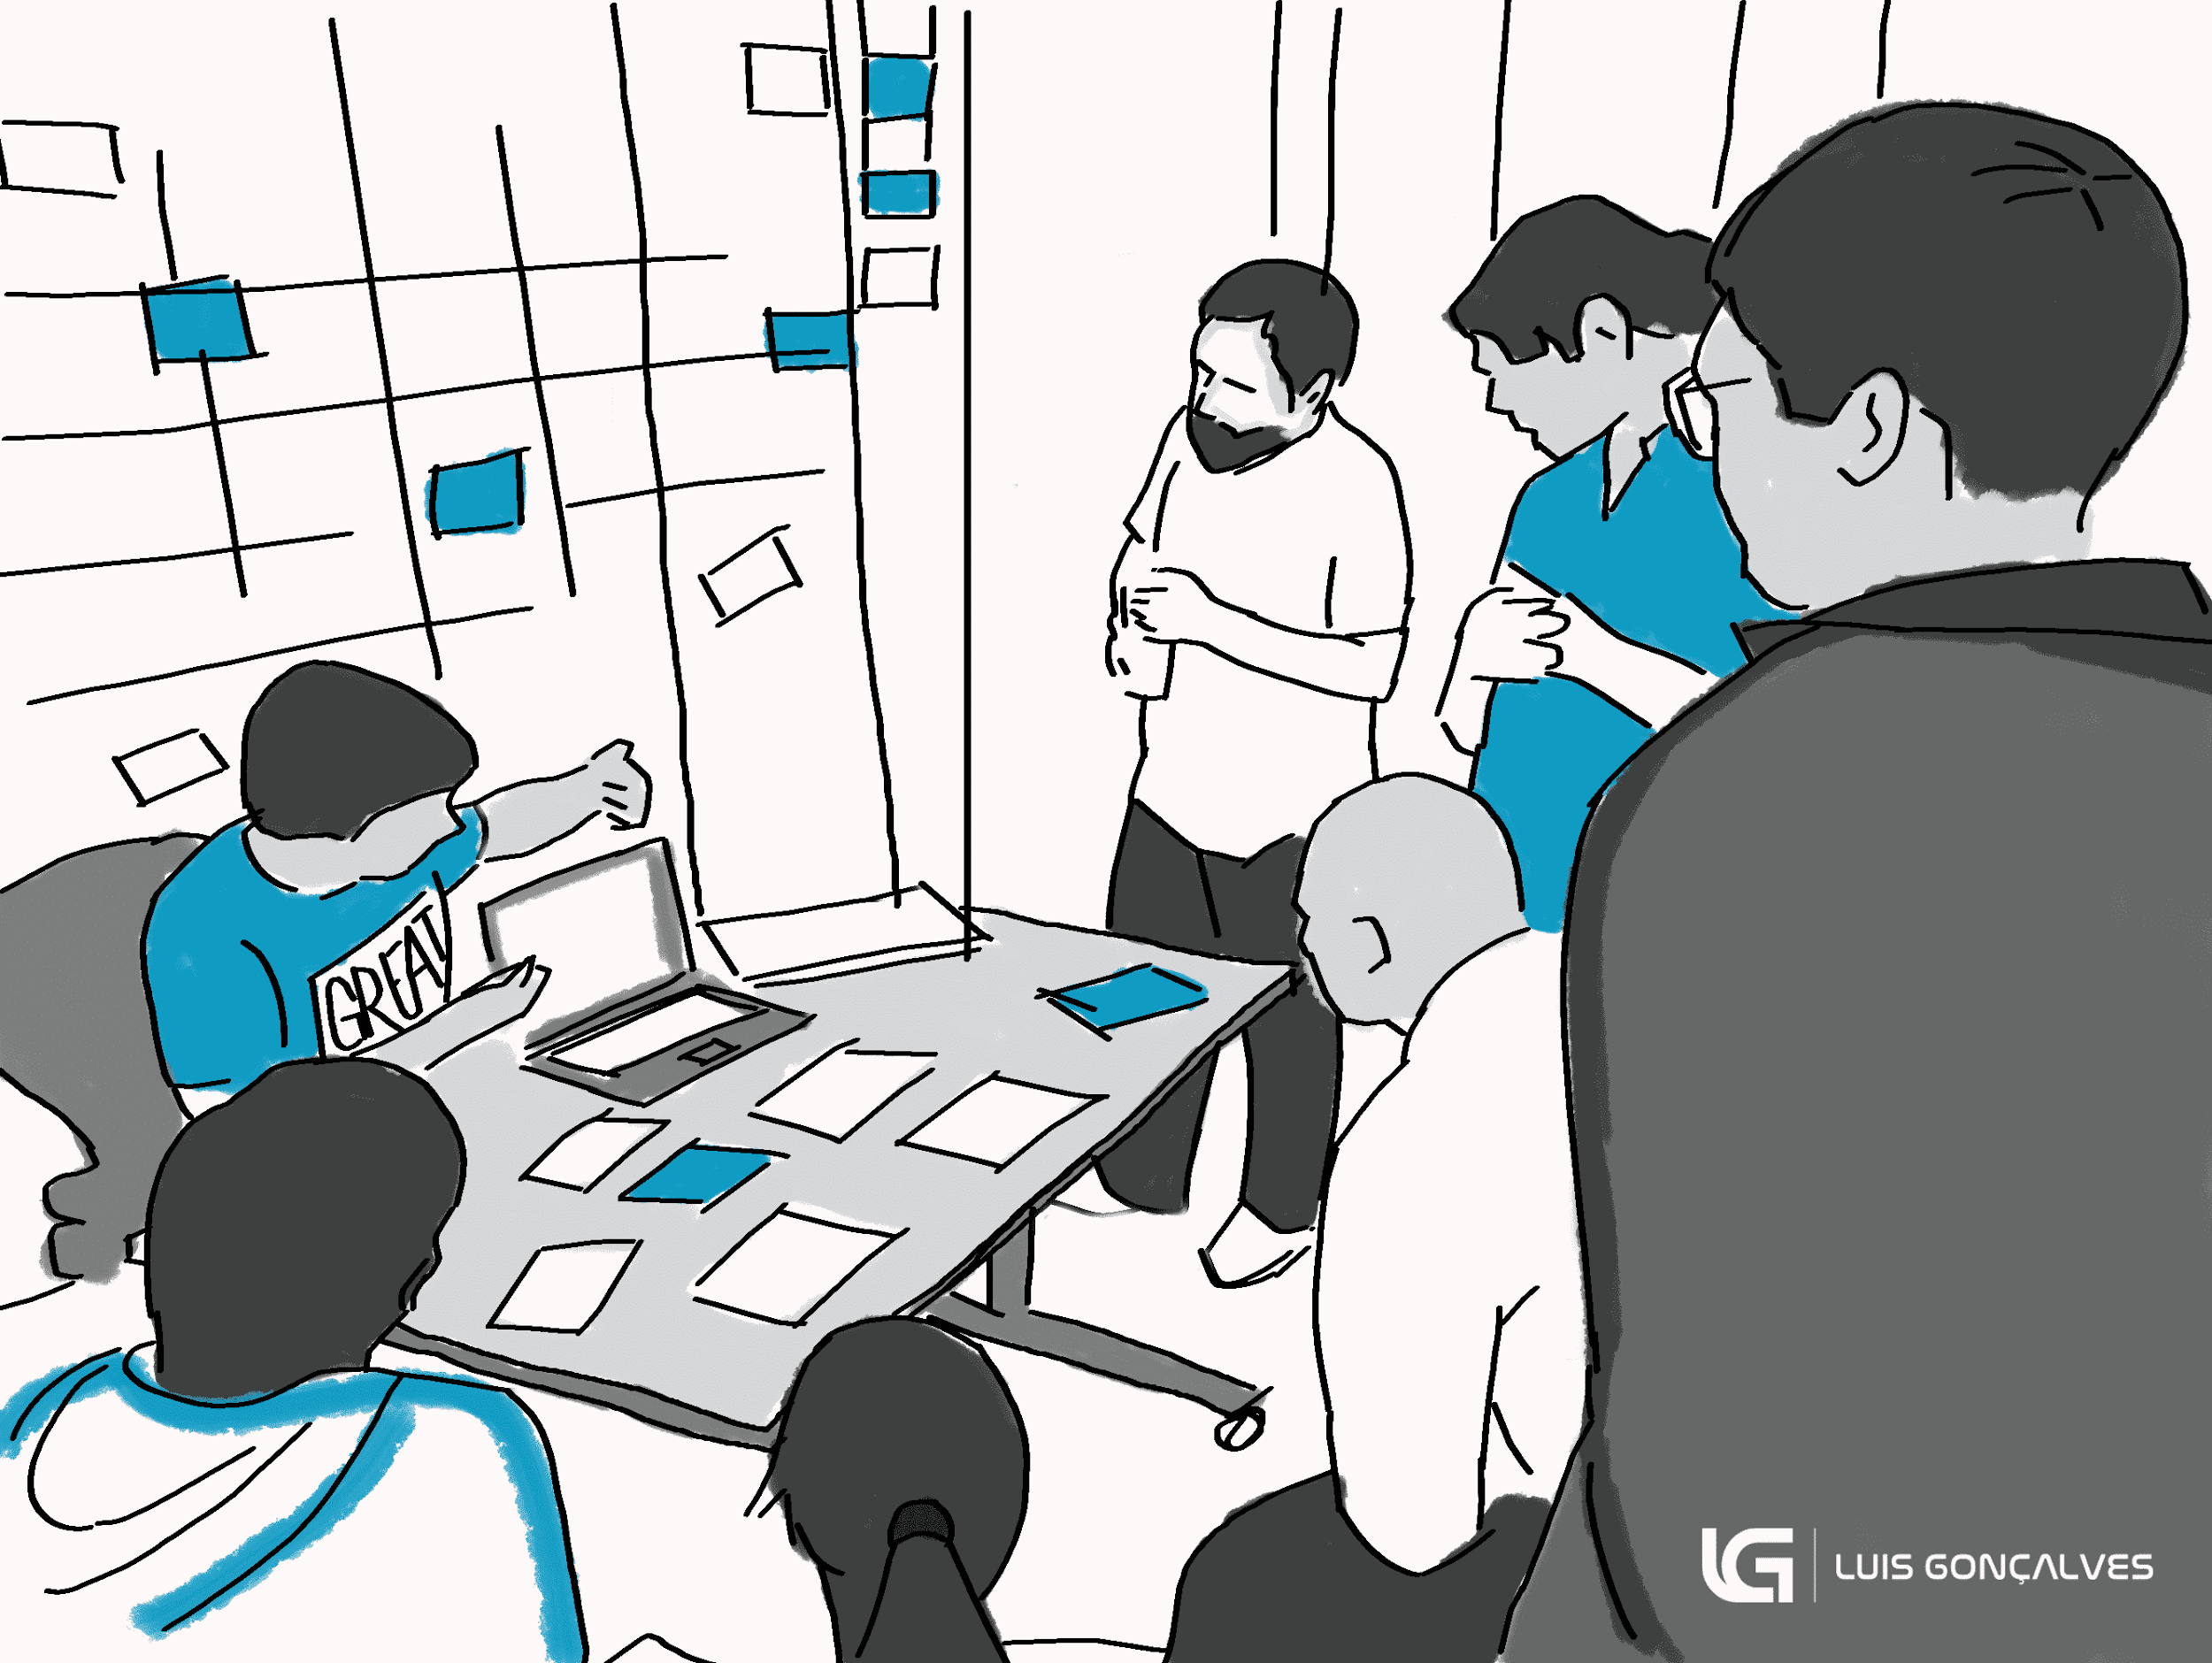
Sprint 1 Demo
[1]
[1] https://luis-goncalves.com/sprint-review-meeting/

Slide 27
Sprint 1 - Implementation Core Areas
Theme - Analyse existing HR Recruitment Processes
Epic 1 - As a team we want to analyze the existing HR Recruitment processes
Theme - Market Research on the Recruitment Tools
Epic 2 - As a team we want to research on the tools currently available in the market

Slide 28
Steps involved in the Recruitment Process
DEFINING REQUIREMENTS
Explicitly and in detail write up for skills,experience and background required for the Job. Should also include a list of daily activities and responsibilities
HIRING AND ONBOARDING
PLANNING CAMPAIGNS
The candidates hiring and onboarding process involves documentation and salary negotiations after which the final contract is signed
Creating a recruiting strategy for attracting the candidates and out forth requirements
SELECTING CANDIDATES
ATTRACTING CANDIDATES
Once the applications are in, a well established and unbiased process needs to be in place in order to hire the right candidate
Applying the recruitment strategy to attract candidates to apply for the position
[1]
[1] Powerpoint Smart Art

Slide 29
Employee Survey
We performed a survey and these are some issues that we discovered that candidates faced in the recruitment process:
A company tends to hire and promote candidates – selecting, developing and sponsoring people who are like them, have similar backgrounds, or who have attributes similar to their own which they tend to value over others
The type and background of the person previously in a role, as well as the composition of the broader team, often influences who is regarded as most suitable to fill a vacancy
Someone who behaves in a way that is inconsistent with commonly-held stereotypes and the associated exceptions may be viewed negatively in hiring and other processes
Equal pay - Most of the companies even today offer a greater pay to men than women and there is also a difference in pay when black and white employees are compared
The criteria for more senior roles are subtly skewed in favour of the dominant ‘in-group’ (which is typically white, heterosexual, middle-aged and male)

Slide 30
Bottlenecks in Recruitment Process
Not Being Ready for Excellent Candidates
Tardiness in hiring the right people (especially when you have a lot of them in the funnel) due a discrepancy-filled or unclear process can become a big problem. The best thing you can do here is to streamline the acquisition process and duly notify the candidates of your timeline. [1]
Hesitant Recruitment or Over-the-Top Critical Hiring Supervisors
Being unsure of whom to hire all the time and being over-critical can be an epidemic when it comes to recruitment bottlenecks. The human resource department must always positively intervene and get rid of delays in hiring. If the hiring manager is being indecisive, he must be supported and encouraged to make a good choice. If the manager is being choosey, simply and politely mention they are wasting a lot of time and money. [1]
No recruitment marketing plan
Too often when a position becomes available, recruiters skip a few steps ahead and become overly eager to fill the position as quickly as possible. Little time is put into actually defining the calibre of candidate this job role should attract and creating a strategy targeted specifically towards them. [2]
[1] https://aepiphanni.com/blog/10-recruitment-bottlenecks-and-how-to-solve-them/
[2] https://www.socialtalent.com/blog/recruitment/10-real-reasons-recruitment-strategy-failing

Slide 31
D & I Challenges in the Recruitment Process
Losing out on Talent due to recruiter bias
Bias in recruitment is losing companies top talent. New survey highlights alarming rates of bias within recruitment processes. Less than a third (32%) of HR managers feel confident that they are not prejudiced when hiring employees.
Accommodation of Beliefs/Ethnic and Cultural Differences
Diversity in cultural, spiritual, and political beliefs can sometimes pose a challenge in a diverse workplace. Employees need to make sure to keep their ethnic and personal beliefs independent of their work responsibilities and duties. Any prejudice and discrimination should never be tolerated in the workplace . Internal company policies with clear and objective regulations should be put in place to prevent employees from demonstrating prejudice.[1]
Language and Communication
Language and communication barriers are ever-present in companies with a diverse workforce. Often, US or UK companies hire people whose native tongue or first language is not English, so employees and managers sometimes have difficulties in getting their message across. This can lead to miscommunication and productivity loss.[1]
Acceptance and Respect
A fundamental value that contributes to a successfully diversified workplace is respect among workers and employees. When there is a lack of acceptance of the diverse culture and beliefs among employees, conflicts may arise. Sometimes, this conflict turns to animosity and may even effectuate situations of violence. When employees accept the differences between each other, it results in a sharing of ideas and effective collaboration.[1]
[1] https://thiswayglobal.com/blog/2017/07/14/top-diversity-issues-in-the-workplace/

Slide 32
Upcoming Trends in Diversity and Inclusion
OLD RULES | NEW RULES
Diversity is considered a reporting goal driven by compliance and brand priorities | D&I is a executive level priority and considered important throughout all levels of management
Compliances measure diversity through demographic profile of designated groups defined by gender,age,nationality and age | Companies measure inclusion, diversity, lack of bias in all recruitment,promotion, pay and other talent practices. Diversity is defined in a broader concept such as “diversity of thought”. It also includes people with cognitive differences
Companies regularly report progress on diversity measures | Companies hold managers accountable for creating inclusive cultures
Candidates are chosen on certain “Metrics” which are predefined and outdated | “Metrics” are unpacked to identify all built in biases. People are selected based on their skill, suitability for the job and experience
[1]
[1] https://www2.deloitte.com/us/en/insights/focus/human-capital-trends/2017/diversity-and-inclusion-at-the-workplace.html

Slide 33



SWOT Analysis
[1]
STRENGTHS
WEAKNESSES
Employees feel accepted & valued
Greater innovation & creativity
Better service to diverse customer base
Boost company’s reputation
Communication barriers leading to resentment
Different understanding of professional etiquette
Narrow understanding of “Diversity”
THREATS
OPPORTUNITIES
No Diversity Officer role
Disengaged employees
Limited creativity in organizational structure
Diversity and inclusion initiatives are weak
Offers wider talent pool & revenue-earning opportunities
Decentralized decision making process
Drive leader accountability for D&I process
[1] Powerpoint Smart Art & https://greengarageblog.org/11-pros-and-cons-of-diversity-in-the-workplace
Notes:
https://greengarageblog.org/11-pros-and-cons-of-diversity-in-the-workplace
https://futureofworking.com/11-advantages-and-disadvantages-of-diversity-in-the-workplace/
https://www.hult.edu/blog/benefits-challenges-cultural-diversity-workplace/#career
Threats:
Disengaged employees: This is because diverse perspectives and opinions can also be distracting as it can build a hostile environment to work.
No diversity officer role:
Strengths
Better service to diverse customer base: Marketing efforts targeting new countries are a lot successful when the skill set and knowledge of the local talents in a particular country should be utilized. Thus, it will help companies to become able in serving a diverse customer base.
Boost company’s reputation: Diversity connects organization to the community around it. After all, when you employs a diverse workforce, then your workforce directly reflects the community where you are located – and possibly, the community that you serve. Beyond that, a national and international reputation of inclusion can go a long way toward building favor, both in your industry and as a recognized brand.
Greater innovation & creativity: Employees from diverse backgrounds will bring diverse solutions to achieve a common goal.
Employees feel accepted & valued: Diversity and inclusion in the workplace cause all employees to feel accepted and valued. When employees feel accepted and valued, they are also happier in their workplace and stay longer with a company. As a result, companies with greater diversity in the workplace have lower turnover rates
Opportunities
Offers wider talent pool & revenue-earning opportunities:If employee selections should not be governed by criteria such as educational experience, location, and age group, there is a huge possibility of finding the right match between the employee and the employer.
The companies which focus on diversification are the businesses which tend to see more sales and revenues because of their efforts. Emphasizing multiple language fluency for a team can boost their profits by 10% for every fluent language that is spoken. Gender diversity can help revenues grow by 40% in the first year of this effort. This advantage can open new markets for the organization that can help profits to start climbing as well without a significant increase in the work of the team.
Weaknesses
Communication barriers leading to resentment: People from different cultures may not speak the same language as their primary communication option. Hiring people from different areas can provide unique perspectives, but it can also cause issues with how co-workers speak with one another. Even when the same language is spoken, there can be differences in the meaning of certain words or jargon understanding problems that can create confusion in the workplace.

Slide 34
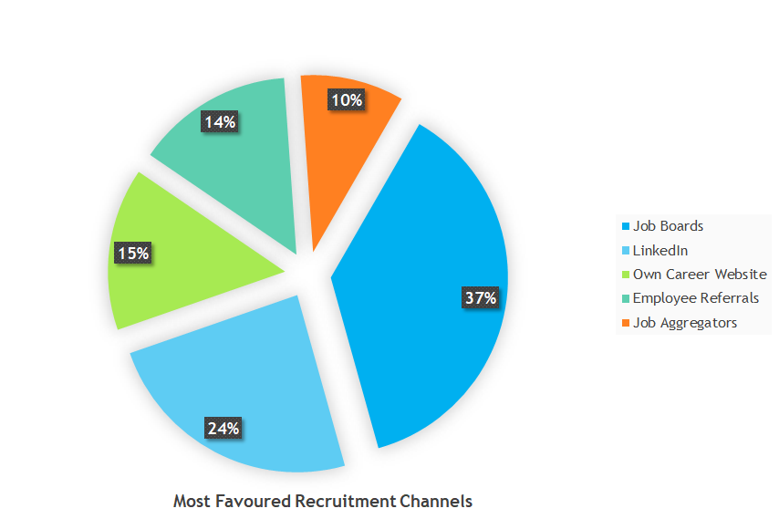
Resume Sourcing Channels
[1]
[1] Powerpoint Smart Art

Slide 35

Market Research - Recruitment Tools
SmartRecruiters [2]
SmartRecruiters helps businesses get the talent they need to succeed. And to help people find a job they love.
Source - Expand your sourcing reach and reduce time-to-find using SmartRecruiter’s integrated sourcing tools and channels.
Market - Reach large pools of qualified talent by distributing your job posts across dozens of job boards.
Convert - Deliver candidates a modern and localized experience for deeper interactions throughout the candidate journey.
Collaborate - Accelerate time-to-hire by facilitating hiring team collaboration.
Evaluate - Improve quality of hire by standardizing candidate evaluation criteria and keeping hiring decisions transparent.
Select - Applicant Tracking Software to make the application, interview and overall hiring processes transparent and simple to manage.
Offer - Simplify the most critical step of the hiring process by managing your offers within the platform
Hire - Achieve hiring success by measuring and improving every important factor, from hiring velocity, cost of hiring, quality of hire, candidate satisfaction, and team engagement, to recruiter productivity with SmartRecruiter.
[1]
[2]
[1] https://www.google.com/search?q=smartrecruiters
[2] https://www.smartrecruiters.com/recruiting-software/smartrecruit/
Notes:
https://www.smartrecruiters.com/about-us/
https://www.smartrecruiters.com/recruiting-software/smartrecruit/
https://www.smartrecruiters.com/recruiting-software/?campaign=Brand&adgroup=Brand&displayterm=smartrecruiters&gclid=Cj0KCQjwhtT1BRCiARIsAGlY51KfhINaMT97_MSznwuLWPoTyVSUsKdrFffelhfmmdmYq8jy7YDxf8MaAtvOEALw_wcB

Slide 36

Market Research - Recruitment Tools
AllyO
AllyO is the leading end to end recruitment AI and automation software that helps recruiting teams to source, screen, and schedule candidates which results in time and cost savings.
Organizations are able to accelerate their time-to-hire by 4X and delight candidates by 2X industry standards.
AllyO’s flagship product, AllyO RECRUIT, is the end-to-end recruiting AI and automation platform recruiting teams rely on to:
Engage and capture applicants wherever they are through text, Whatsapp, and web chatbots
Intelligently qualify applicants for the best-fit role and eliminate applicant drop-off rate to under 5%
Automate interview scheduling and reminders to increase recruiter productivity by over 40%
Plug-in seamlessly with the market-leading ATS and calendar systems and keep candidates moving smoothly through the hiring process
Deliver peace of mind with rock-solid security and compliance
Features:
AllyO Assist — an AI-powered chatbot that answers frequently asked questions from candidates or employees 24×7
AllyO Connect — the business texting solution for HR and recruiting teams that delivers 4X more and faster responses than email
AllyO Schedule + Video — the AI scheduling solution with optional live video interviewing capabilities
AllyO Survey — automated conversational surveys for new employee check-ins, exit interviews and more, increasing responsiveness by 3x
[2]
[1]
[2]
[1] https://www.google.com/search?q=allyo+ai+recruiting
[2] https://www.allyo.com/technology/
Notes:
https://www.allyo.com/company/our-story/
https://www.allyo.com/technology/

Slide 37

Market Research - Recruitment Tools
Paradox
Paradox is the AI driven company that believes recruiting is a people game.
Paradox’s flagship product is Olivia, the AI recruiting assistant focuses on automation, intelligence and providing with good candidate experience.
Olivia delivers personalized candidate experience at scale:
Real-time communication via the web, mobile, SMS, and social platforms including WhatsApp, Facebook Messenger and WeChat
A broad suite of products to assist candidates and employees through the hiring, onboarding and career lifecycle
Proven at scale, Olivia supports more than 150 organizations in 60+ countries, across 6 continents
Olivia speaks 36+ languages daily and can support over 100 languages
Industry-leading privacy and security, including GDPR and ISO 27001 compliance
Seamless integration with SmartRecruiters and more advanced multi-platform customizations available
[2]
[1]
[2]
[1] https://www.google.com/search?q=paradox+ai+tool
[2] https://marketplace.smartrecruiters.com/product/paradox-inc/
Notes:
https://marketplace.smartrecruiters.com/product/paradox-inc/

Slide 38

Market Research - Recruitment Tools
XOR
XOR is the global leader in human resource and talent acquisition workflow automation.
XOR is an enterprise-now SaaS platform that will streamline the most challenging and time-consuming processes in recruiting.
XOR’s automated hiring management system provides better experience for job candidates to recruiters:
Attracts the best talent from over 500 sources
Offers 24/7 customer service
Supports 103 different languages
Integrates with major ATS, HRMS and corporate calendar systems
Gives instant responses from our AI chatbot
Is GDPR compliant
Enables Microsoft Azure hosting
Provides predictive analytics and in-depth reports
[2]
[1]
[2]
[1] https://www.google.com/search?q=xor+ai+recruiting
[2] https://www.xor.ai/
Notes:
https://www.xor.ai/how-it-works-recruiting
https://www.xor.ai/
https://www.xor.ai/new

Slide 39

Market Research - Recruitment Tools
Eightfold
Eightfold is using AI to guide career site visitors to the right open jobs. Using data from a resume, they are able to predict which open reqs make sense for a given individual, and thus can greatly increase the conversion rate into your ATS.
Eightfold’s Talent Acquisition solution solves the problems of modern recruiting, bending back the rising cost of hiring and freeing recruiters to focus on landing great candidates instead of repeating administrative tasks.
Key capabilities of eightfold talent acquisition include:
ATS and HRIS Integration - Centralize, de-dupe, clean, enrich, and update talent profiles.
Calibration - The most powerful screening system ever built cuts sourcing time 90%.
Talent Network - Source from your own unique pool of ready candidates for maximum candidate quality.
Instant Pipeline - Get a ranked list of top candidates for every position.
Personalized CRM - Targeted emails get 7x greater response than InMail.
Built-In Scheduling - Set up interviews right from the platform, saving time and hassle.
Talent Analytics - Real-time insights eliminate costly manual reporting.
Resume Book Upload - Bulk import thousands of resumes and create talent profiles in seconds.
[2]
[1]
[2]
[1] https://www.google.com/search?q=eightfold+ai+tool
[2] https://eightfold.ai/
Notes:
https://eightfold.ai/resources/eightfold-talent-acquisition/
https://eightfold.ai/

Slide 40
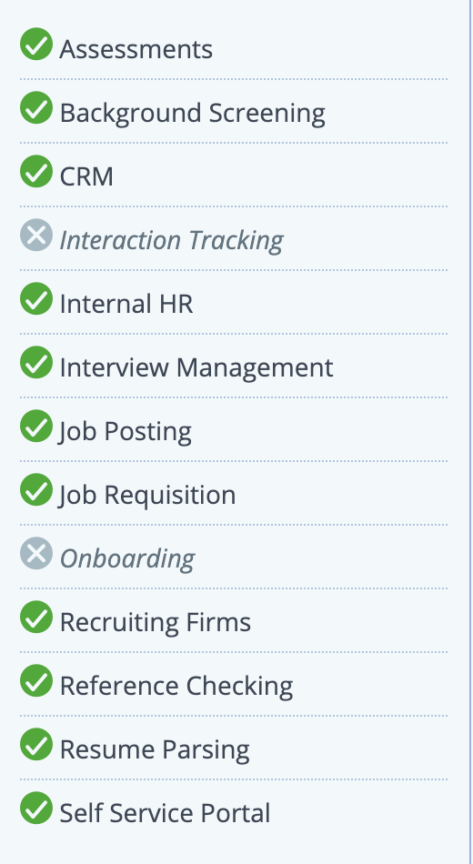
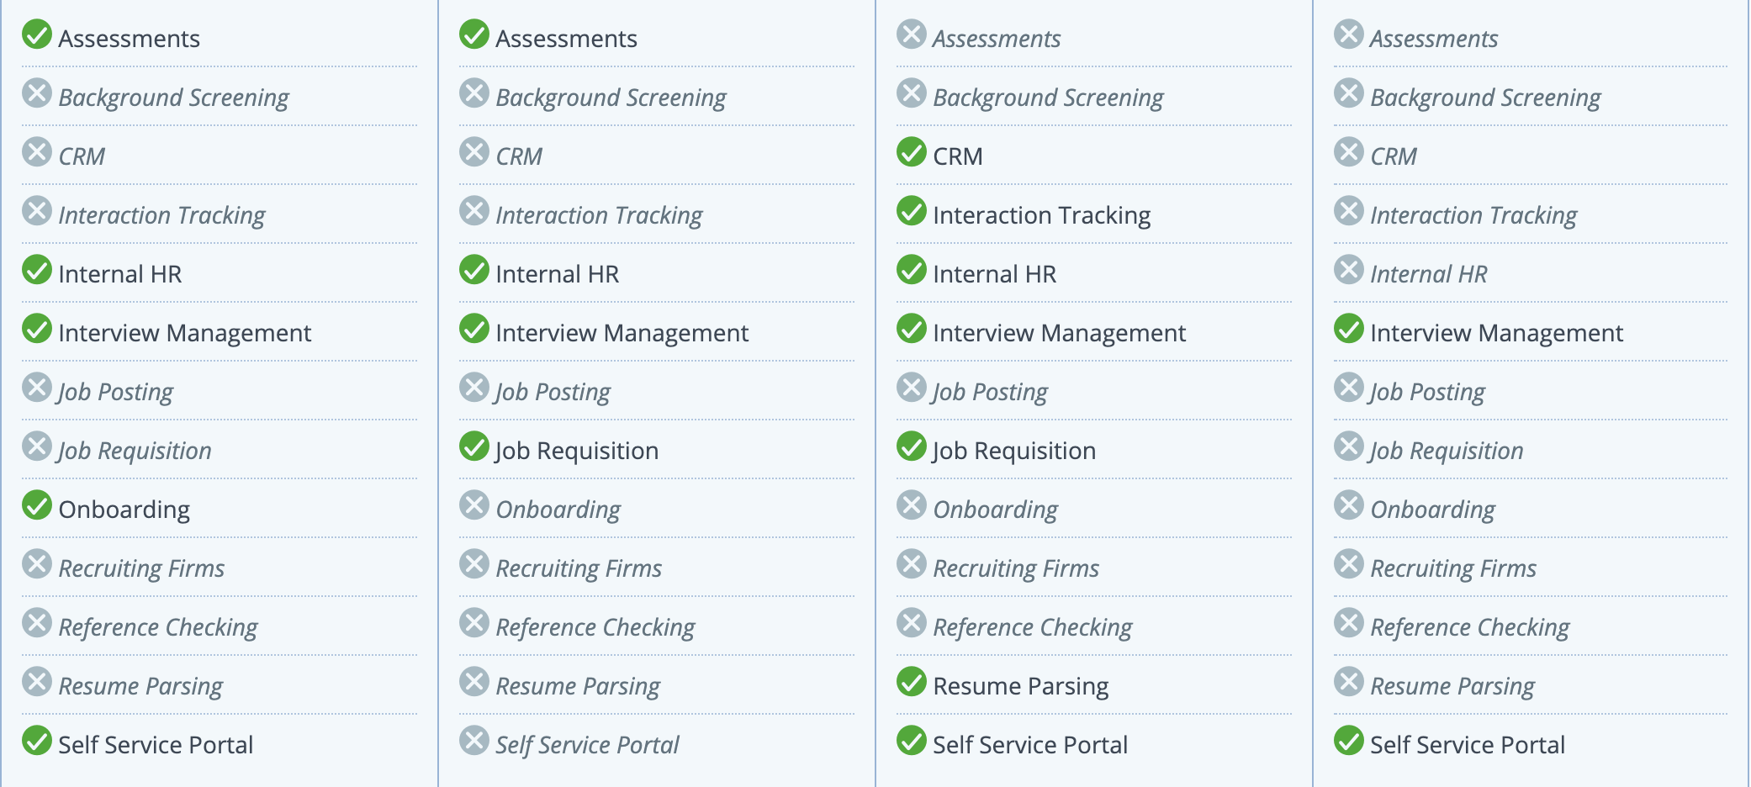
Benchmarking Tools
SmartRecruiters
XOR
AllyO
Eightfold
Paradox - Olivia
[1]
[1]
[1]
[1]
[1]
[1] https://www.smartrecruiters.com/recruiting-software/smartrecruit/ & https://www.capterra.com/recruiting-software/compare/191075-176982-123833-191163/AllyO-vs-Eightfold-ai-vs-SmartRecruiters-vs-XOR-AI

Slide 41
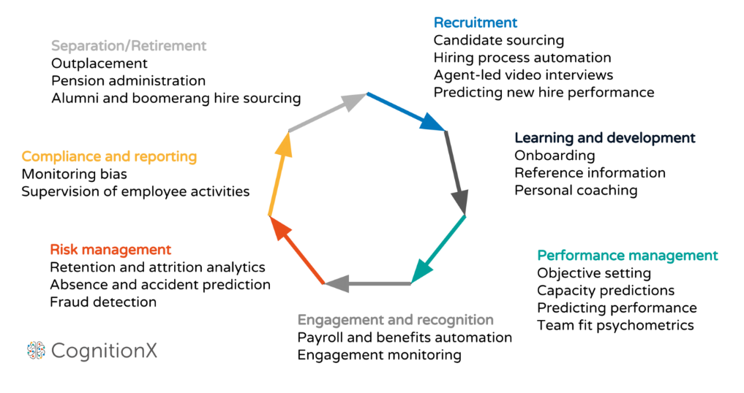
AI Tool Functions
[1]
[1] https://medium.com/@oleksii_kh/hr-is-your-new-hr-5-example-of-using-machine-learning-in-human-resources-a380ef4a77ff

Slide 42

Planning User Stories and Burndown Chart
[1]
[1] https://www.ntaskmanager.com/blog/best-scrum-tools/

Slide 43
Epic 1 - User Stories | Acceptance Criteria | Story Points
As an HR Professional, I want to know about steps involved in recruitment process to have a clear understanding of the recruitment process | The steps should start from the stage when candidate enters recruiting funnel until when he/she is hired. | 3
As an HR Professional, I want to know about the most time consuming part of recruitment process to identify the bottlenecks | Consult with colleagues and recruiters | 3
As an HR Professional, I want to know about the challenges of recruitment process to identify those areas as gaps/challenges that need to be bridged | Consult with colleagues and recruiters | 3
As an HR Professional, I want to carry out a survey to know more about an employee's experience during recruitment and onboarding to know the sentiment | More than 80% of the company's employees including recent hires should have participated in the survey | 2
As an HR Professional, I want to list down all the various channels that are used for resume sourcing | Consult with colleagues and recruiters | 3

Slide 44
Epic 2 - User Stories | Acceptance Criteria | Story Points
As a Research Analyst, I want to perform market research on different recruitment tools currently available | Perform comparative analysis on different tools by doing surveys, interviews, focus groups and customer observation | 3
As a Research Analyst, I want to categorise the tools that help meet challenges of existing recruitment process | Tools identified should be segmented into 3 categories based on the number of challenges that a particular tool helps to meet | 5
As a Research Analyst, I want to carry out SWOT analysis against implementation of each tool | Create report based on SWOT analysis and compare score for each of the tools | 5
As a Sprint Consolidator, I want to document the tool functionalities | The documentation is reviewed/approved by the development team | 1
As a Sprint Colidator, I want to consolidate the findings of the scrum team for Sprint Review 1 | Set up meetings with the scrum team and consolidate findings and the team’s progress | 2

Slide 45
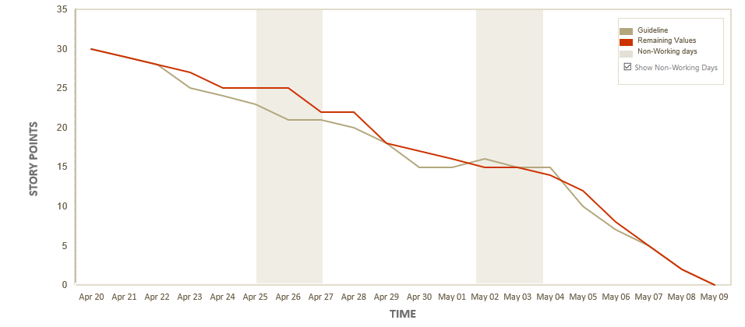
Burndown Chart

Slide 46

[1]
[1] https://images.app.goo.gl/yGFtDc5sHYWB1zPNA

